Slide 1
Data Analysis
Model Development
Simple & Multiple Linear Regression

Slide 2
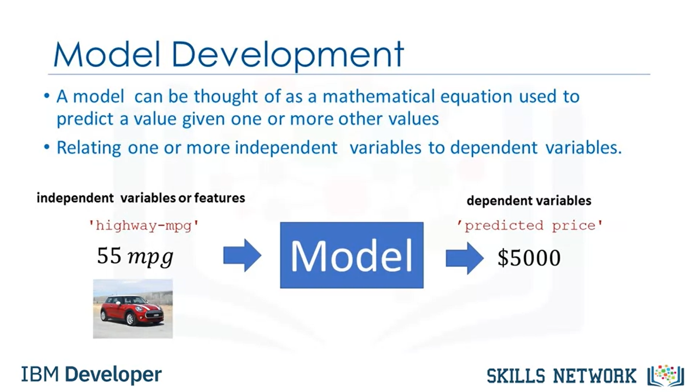

Slide 3
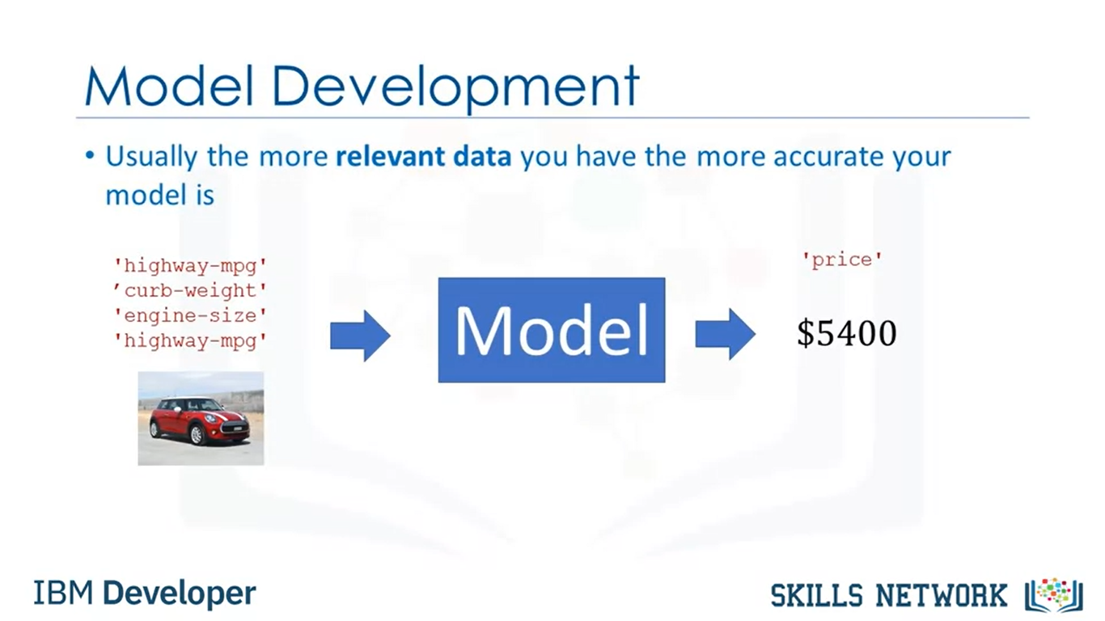

Slide 4
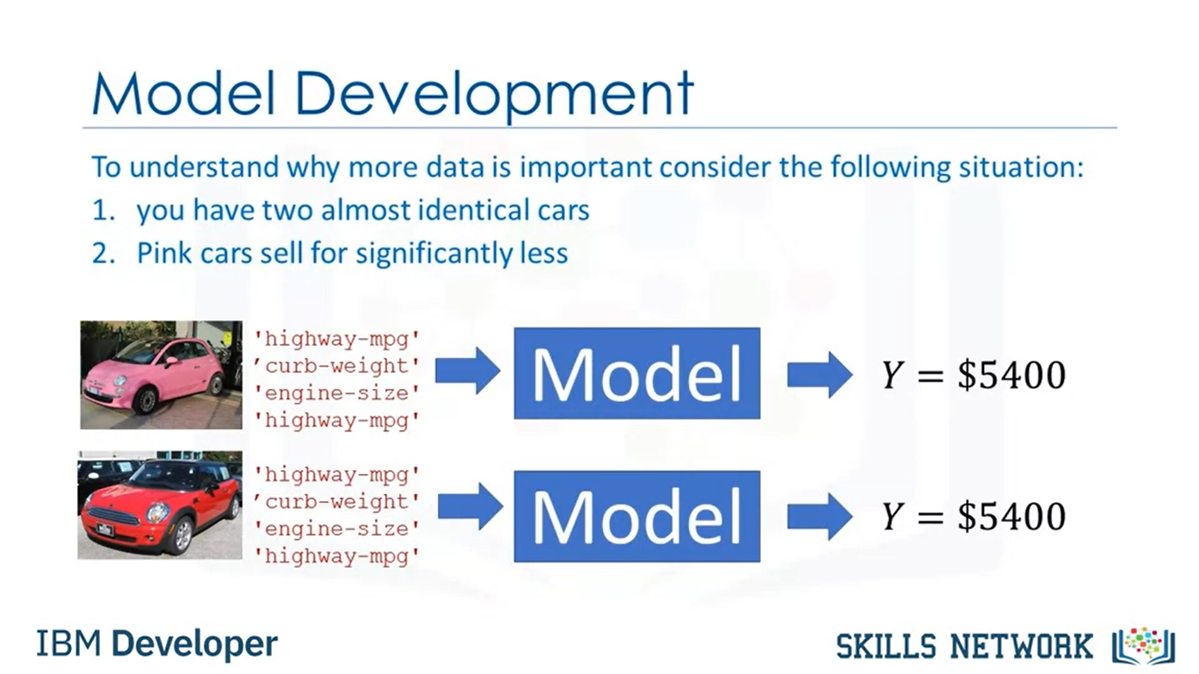

Slide 5
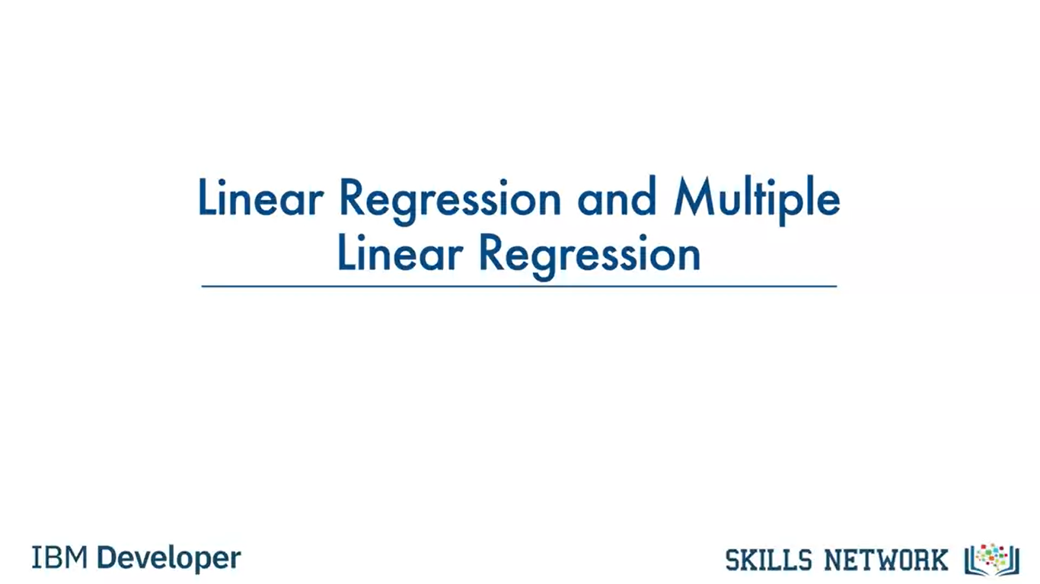

Slide 6
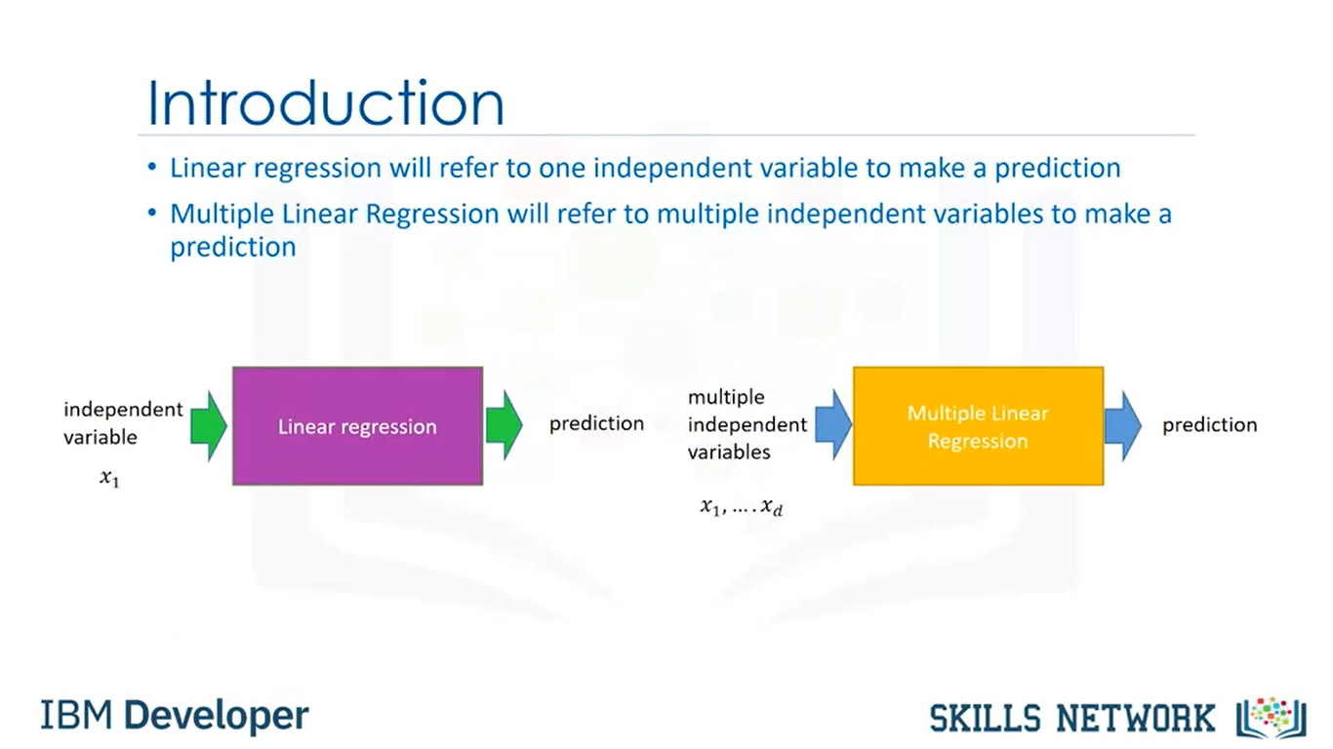
Notes:
Simple linear regression or SLR is a method to help us understand the relationship between two variables.
The predictor independent variable x and the target-dependent variable y.

Slide 7
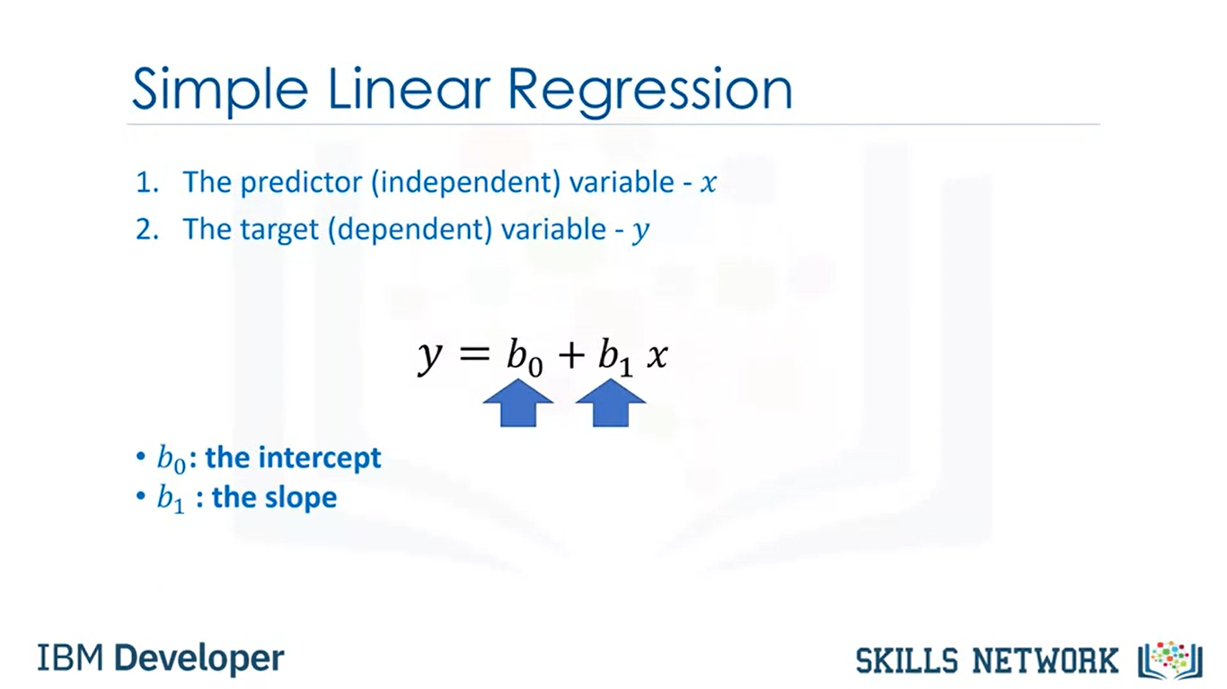
Notes:
We would like to come up with a linear relationship between the variables shown here.
The parameter b_0 is the intercept.
The parameter b_1 is the slope.
When we fit or train the model, we will come up with these parameters.
Let's clarify the prediction step. It's hard to figure out how much a car costs,
but the highway miles per gallon is in the owner's manual.
If we assume there is a linear relationship between these variables, we can use this relationship to formulate a model to determine the price of the car.

Slide 8
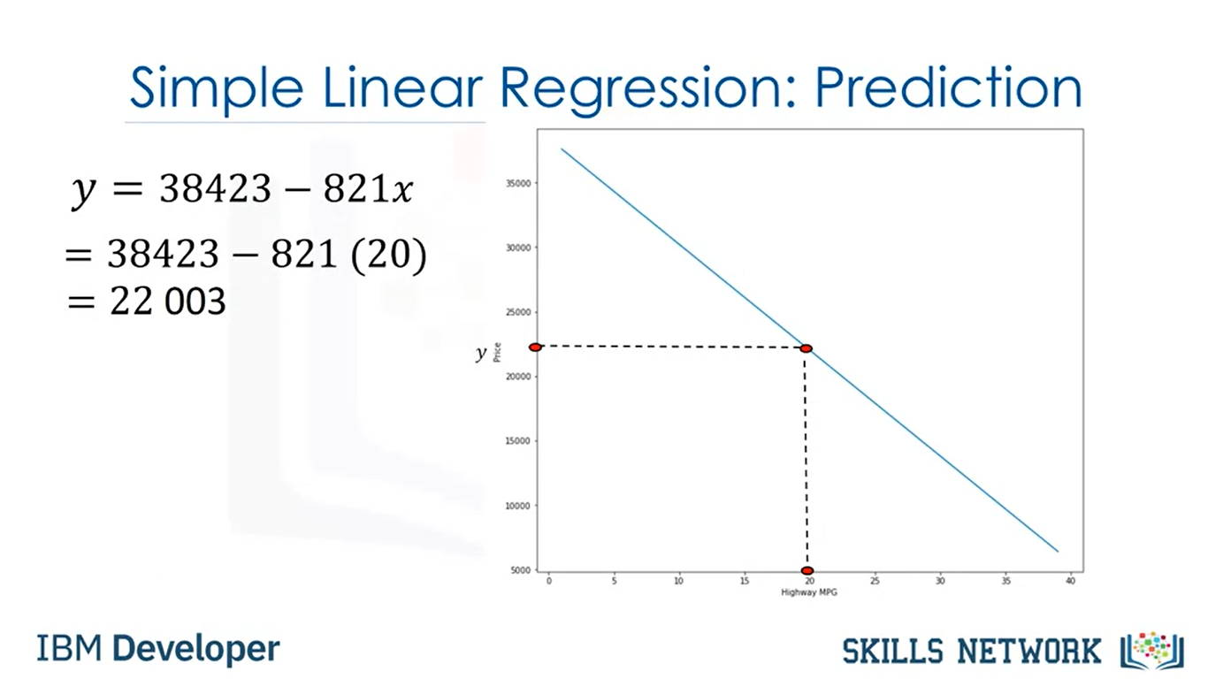
Notes:
If the highway miles per gallon is 20, we can input this value into the model to obtain a prediction of $22,000.
In order to determine the line, we take data points from our data set marked in red here. We then use these training points to fit our model.

Slide 9
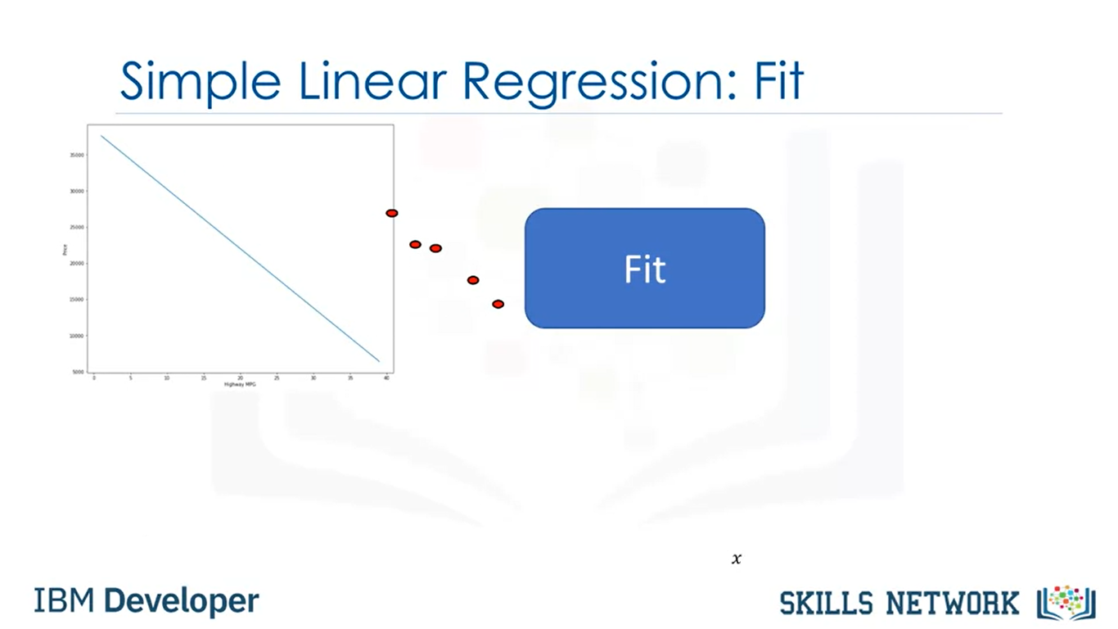
Notes:
The results of the training points are the parameters. We usually store the data points into data frame or numpy arrays.
The value we would like to predict is called the target that we store in the array y.
We store the independent variable in the data frame or array x.

Slide 10
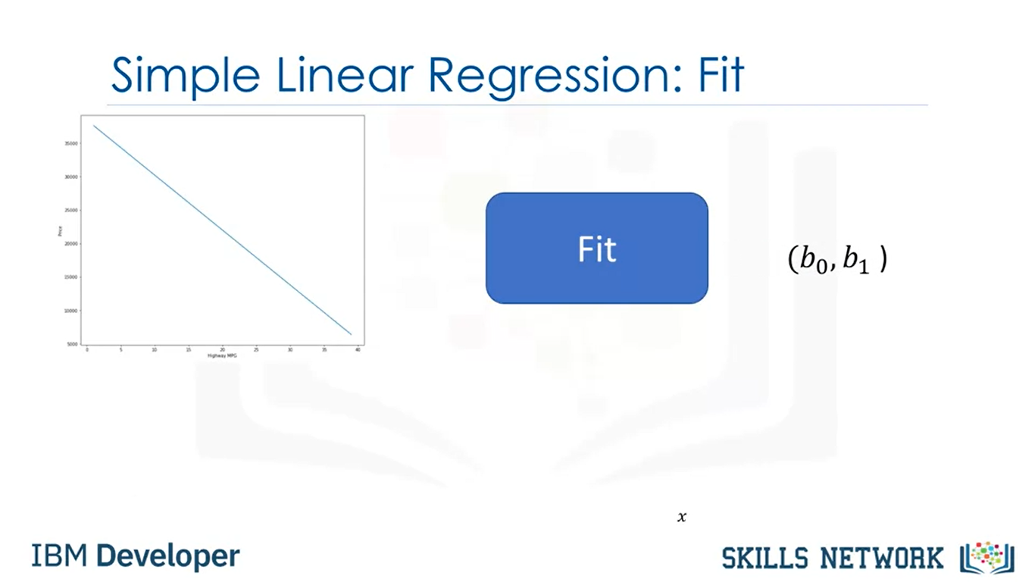

Slide 11
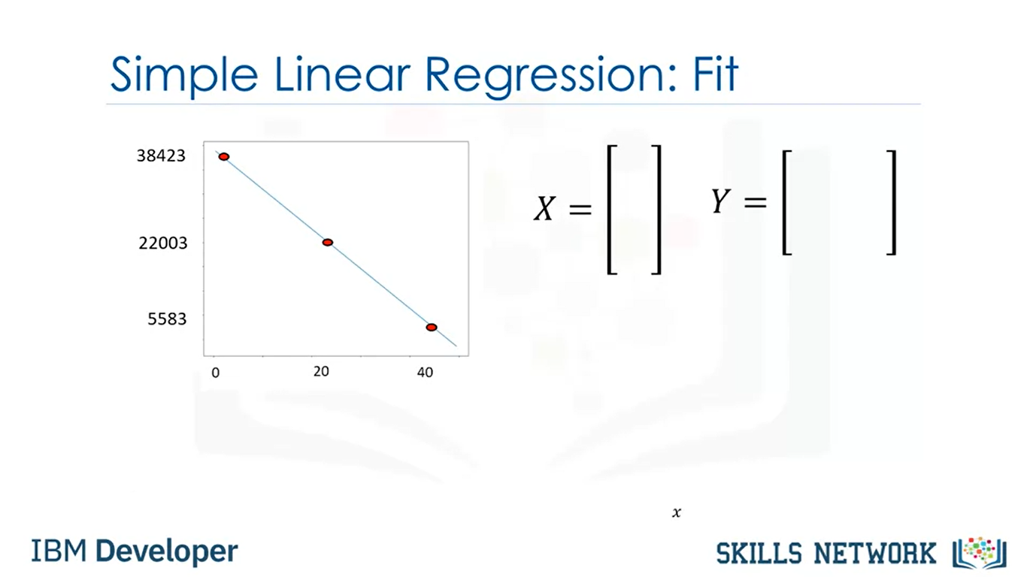

Slide 12
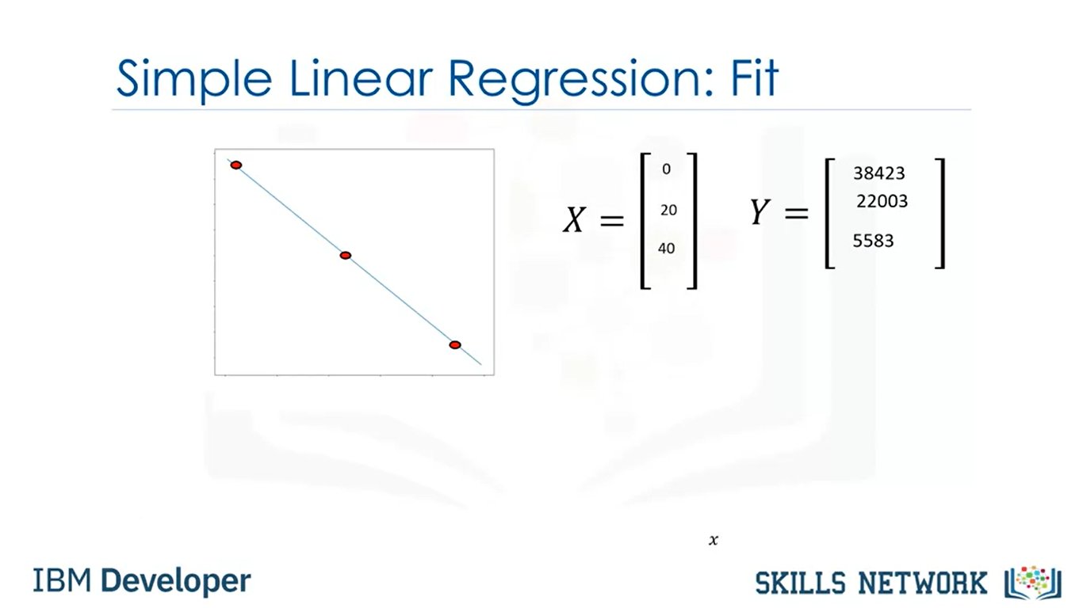

Slide 13
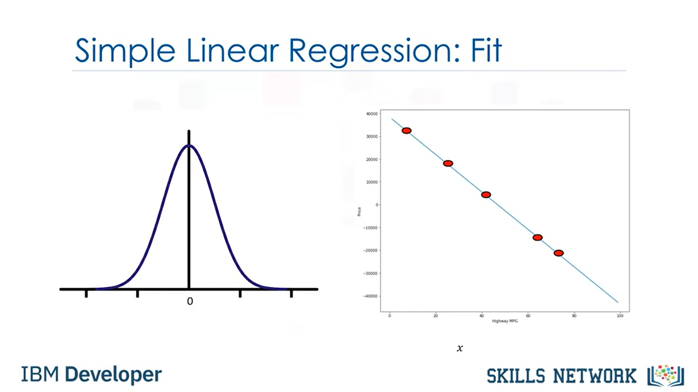

Slide 14
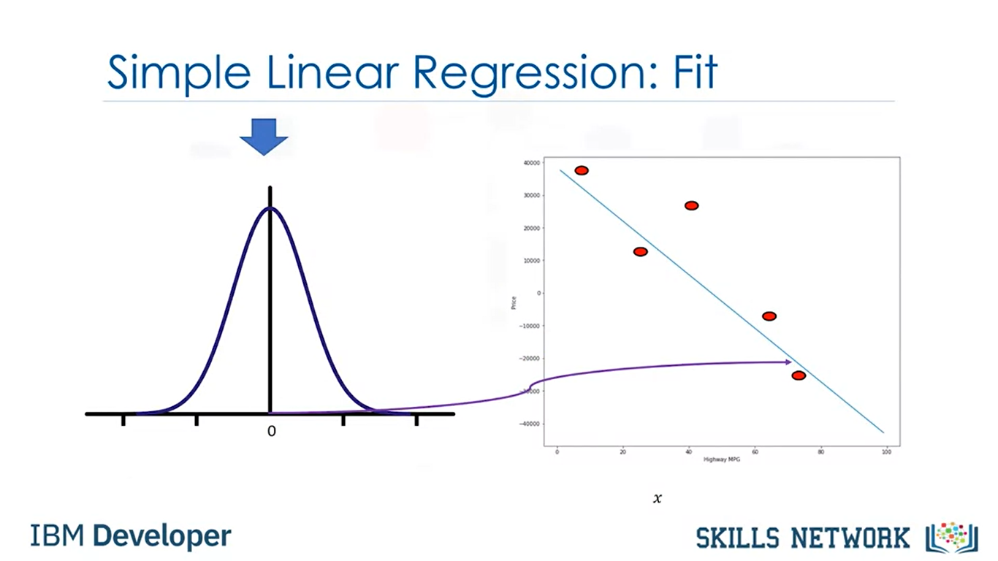
Notes:
Each sample corresponds to a different row in each data frame or array.
In many cases, many factors influence how much people pay for a car

Slide 15
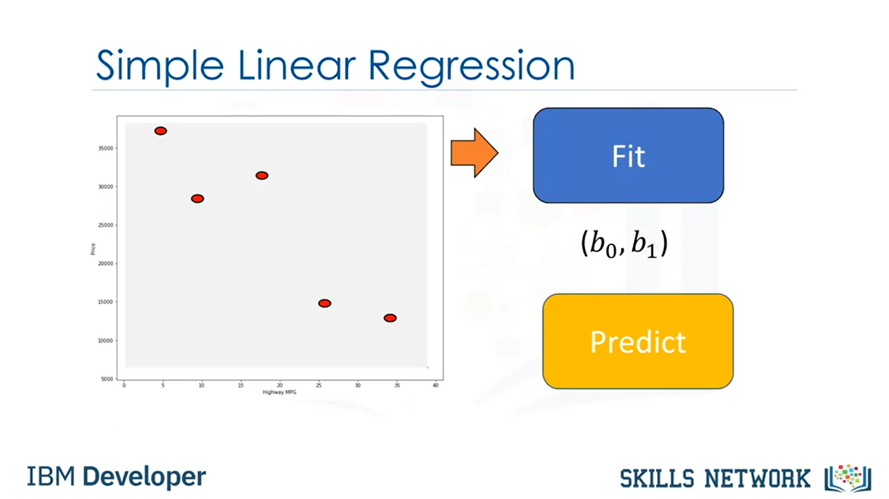

Slide 16
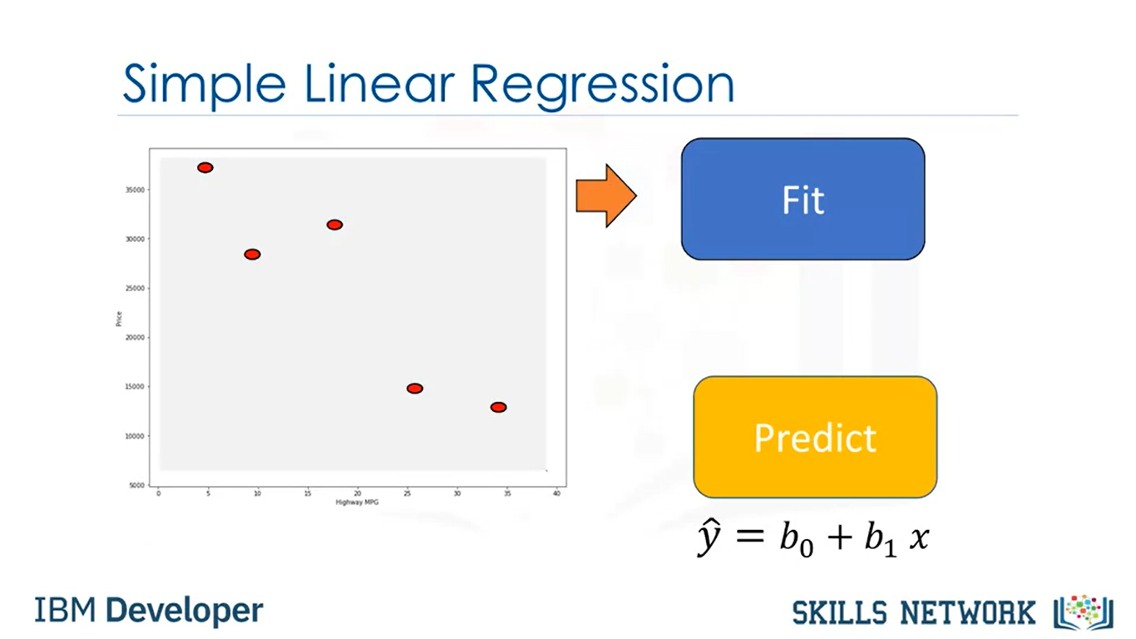

Slide 17
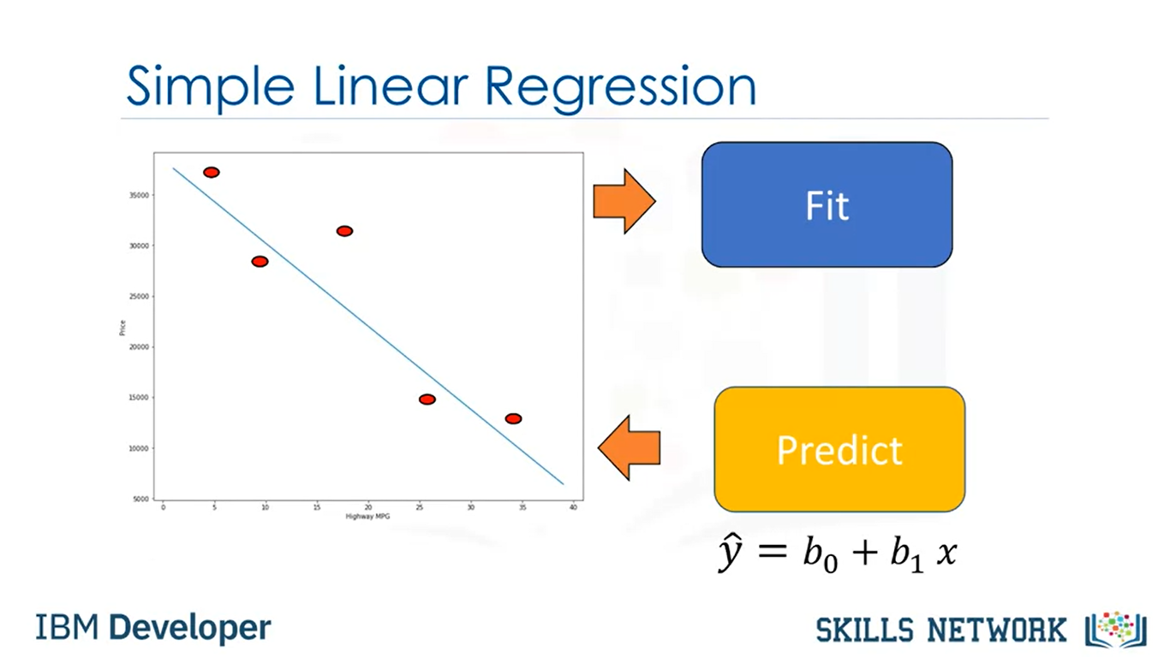

Slide 18
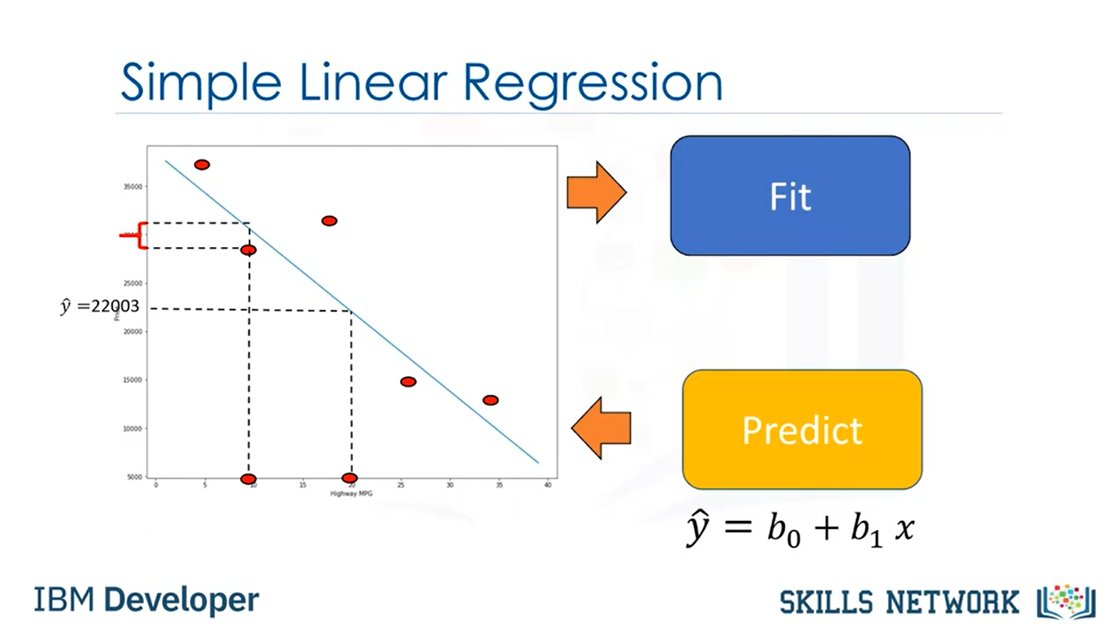
Notes:
For example, make or how old the car is.
In this model, this uncertainty is taken into account by assuming a small random value is added to the point on the line.
This is called noise.
The figure on the left shows the distribution of the noise.
The vertical axis shows the value added and the horizontal axis illustrates the probability that the value will be added.
Usually a small positive value is added or a small negative value.
Sometimes, large values are added. But for the most part, the values added are near zero.
We can summarize the process like this. We have a set of training points.
We use these training points to fit or train the model and get parameters.
We then use these parameters in the model. We now have a model.
We use the hat on the y to denote the model is an estimate. We can use this model to predict values that we haven't seen.
For example, we have no car with 20 highway miles per gallon. We can use our model to make a prediction for the price of this car.
But don't forget our model is not always correct. We can see this by comparing the predicted value to the actual value.
We have a sample for 10 highway miles per gallon but the predictive value does not match the actual value.
If the linear assumption is correct, this error is due to the noise. But there can be other reasons

Slide 19
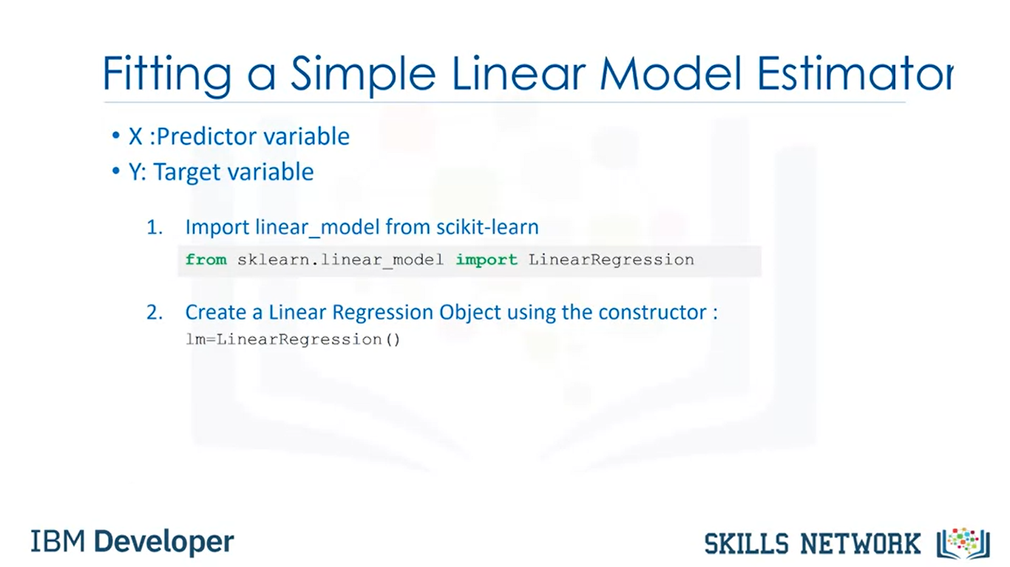

Slide 20
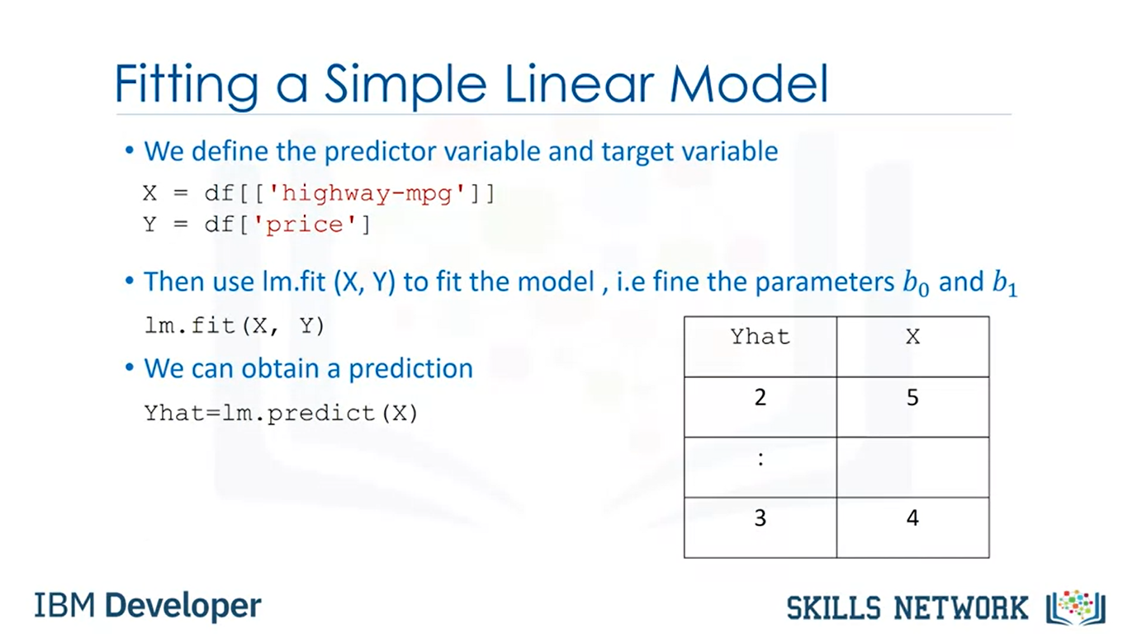

Slide 21
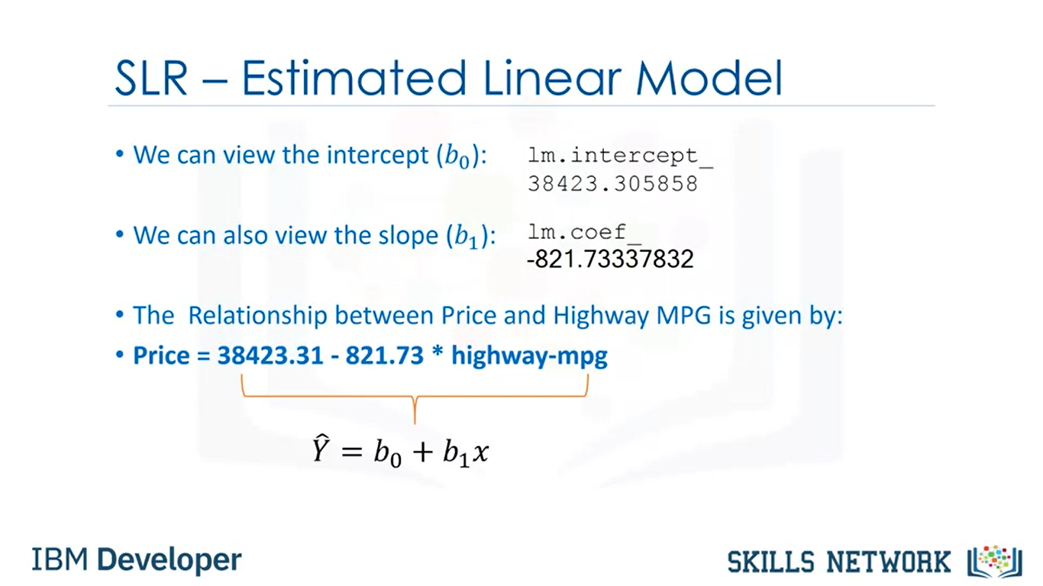

Slide 22
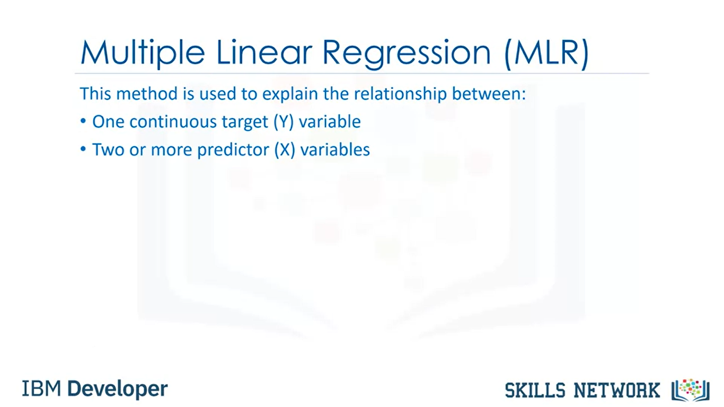

Slide 23
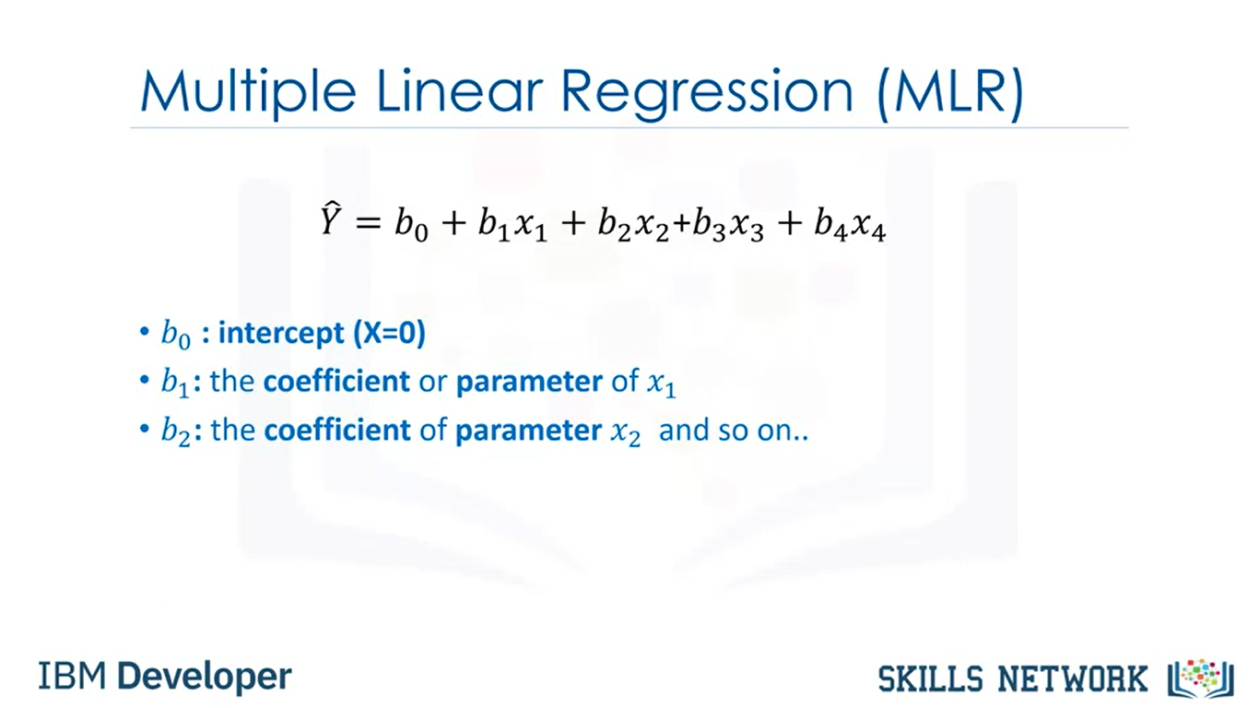

Slide 24
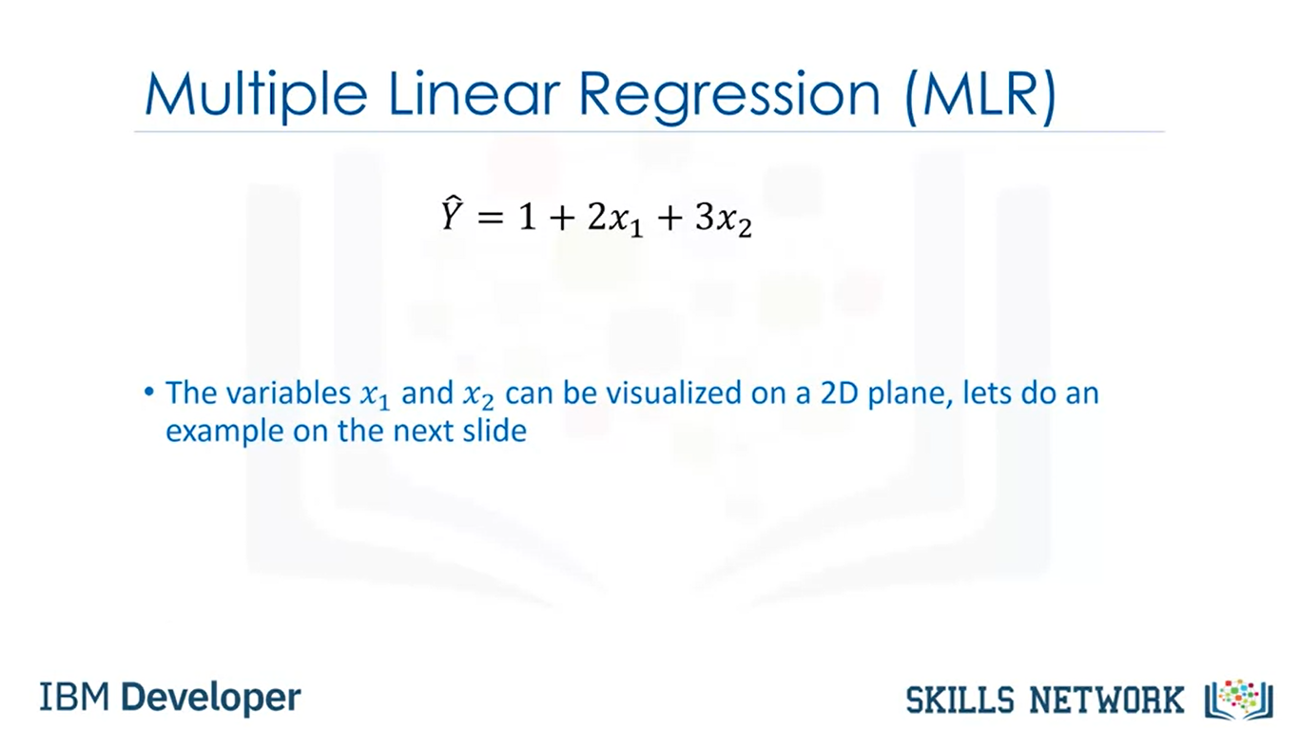

Slide 25
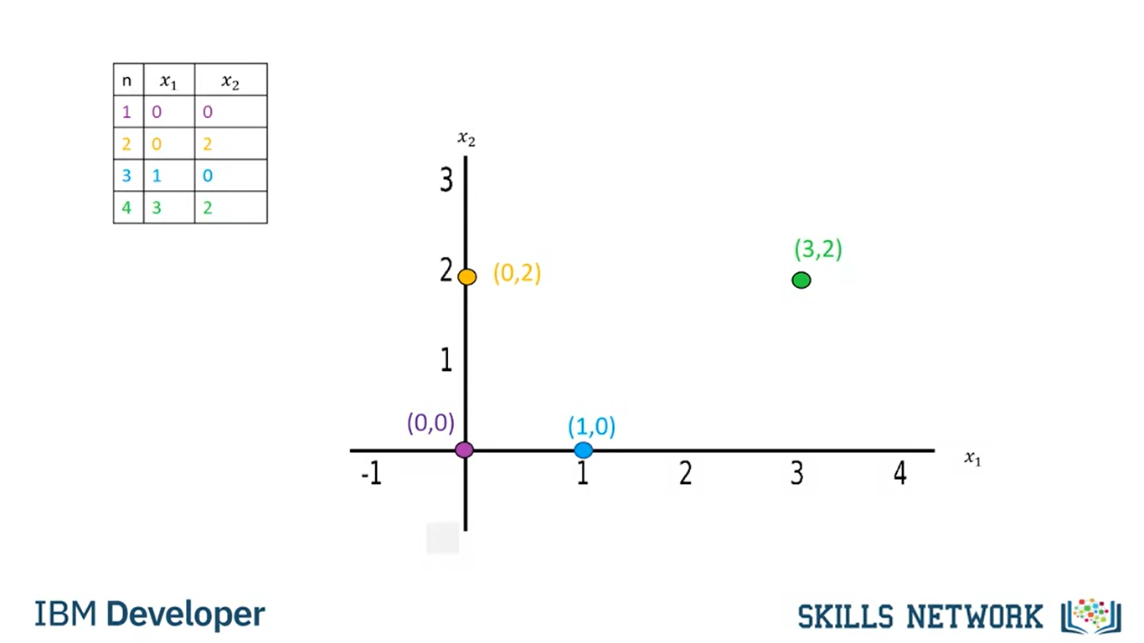

Slide 26
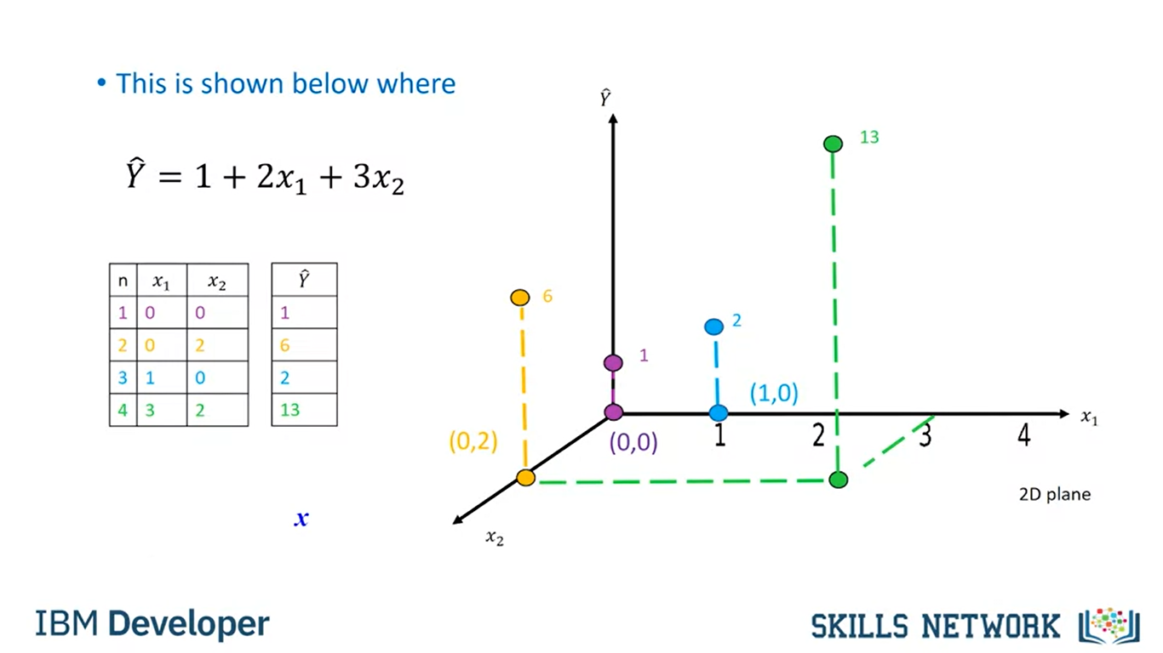

Slide 27
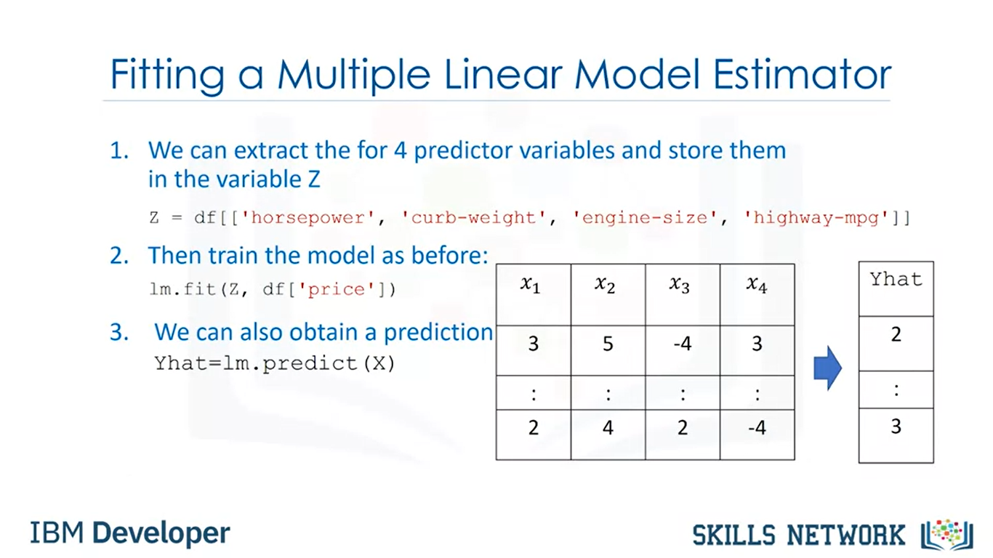

Slide 28
